Slide 1
NISQ Digital Quantum Simulation
Nathan Fitzpatrick

Slide 2
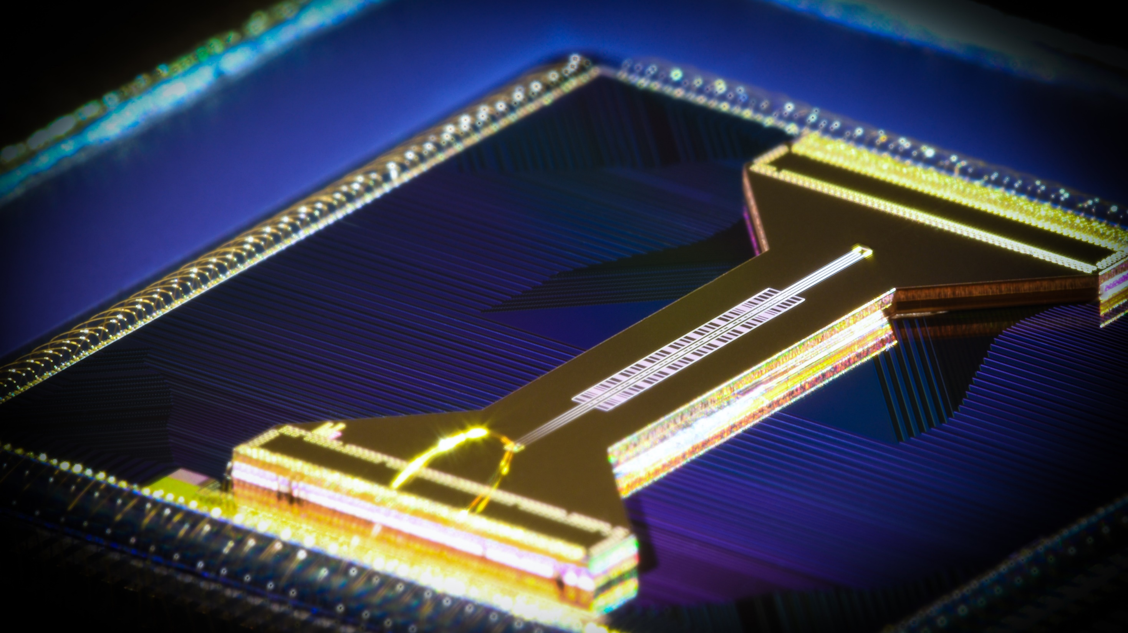
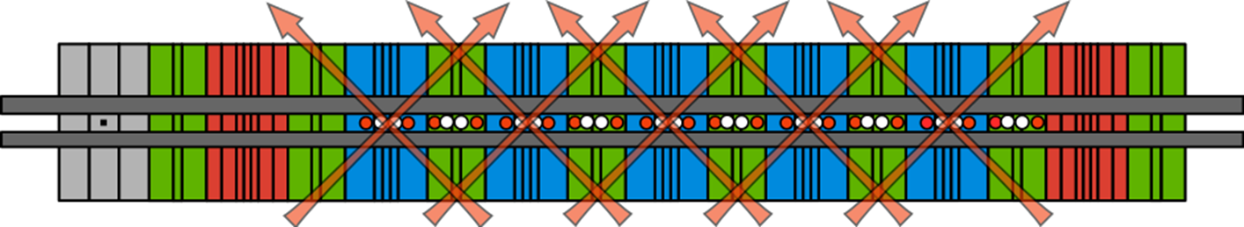
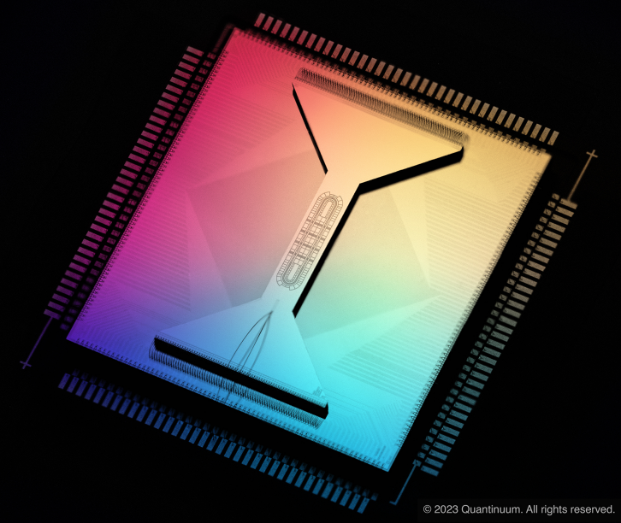
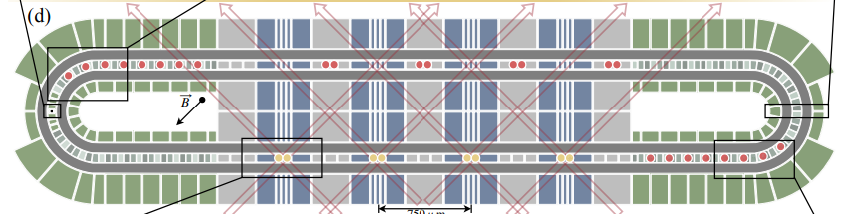
Surface Electrode Ion-Traps (H-series)
¹⁷¹Yb⁺ = qubits, ¹³⁸Ba⁺ = cooling
H1:
20 qubits
Pino, Nature 592, 209–213 (2021)
Gate Zones:
Transport Operations: Shift, split/combine, swap
H2:
32 qubits
Moses, arXiv:2305.03828

Slide 3

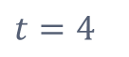
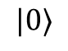
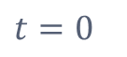
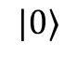
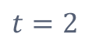
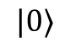
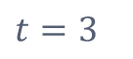
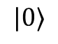
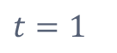
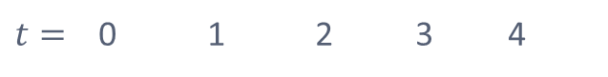
Computing in QCCD systems
$$t=0$$
Quantum Circuit
$$t=1$$
1-qubit gate
$t=$ 0 1 2 3 4
Move, Join
$$|0⟩$$
H
$$|0⟩$$
H
$$|0⟩$$
$$t=2$$
2-qubit gate
$$|0⟩$$
Swap, Split
Move, Join
$$t=3$$
2-qubit gate
Wineland, J. Res. Natl. Inst. Stand. Technol. 103, 259 (1998)
Home, Science 6, (2009)
Kaufmann, Phys. Rev. A 95, 052319
Pino, Nature 592, 209–213 (2021)
$$t=4$$
Measure

Slide 4
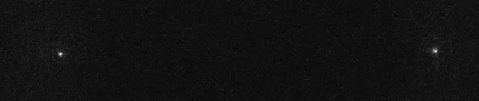

Real-World View
150μm
Split and Combine
Ion is transported into the same zone
Ions are combined into a single potential well and then re-separated
Swap
Ions are carefully manipulated to reorder positions

Slide 5
All-to-All Connectivity
Nearest Neighbor
All-to-All

Slide 6
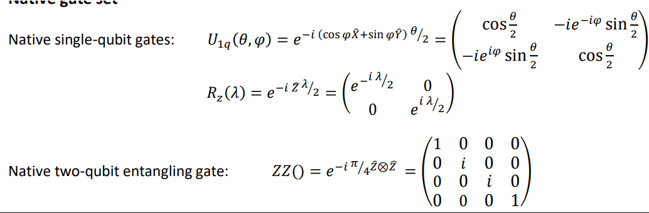
Universal Gate set
You can create any other unitary operation from this set

Slide 7
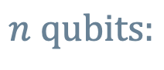
A Qubit
$$n qubits:$$
2 Qubit Entangling

Slide 8

Gate based Digital Quantum simulation
Sam McArdle, Earl Campbell, and Yuan Su
Phys. Rev. A 105, 012403 – Published 3 January 2022

Slide 9
Gate based Digital Quantum simulation
Cannot be factorized for each qubit
Sam McArdle, Earl Campbell, and Yuan Su
Phys. Rev. A 105, 012403 – Published 3 January 2022

Slide 10
Hamiltonians
In most cases the Hamiltonian is a weighted linear combination of unitary Paulis
Tensor Products of Paulis
Sam McArdle, Earl Campbell, and Yuan Su
Phys. Rev. A 105, 012403 – Published 3 January 2022

Slide 11
Hamiltonians
Hamiltonian is the generator of time evolution
Unitary operator
Sam McArdle, Earl Campbell, and Yuan Su
Phys. Rev. A 105, 012403 – Published 3 January 2022

Slide 12
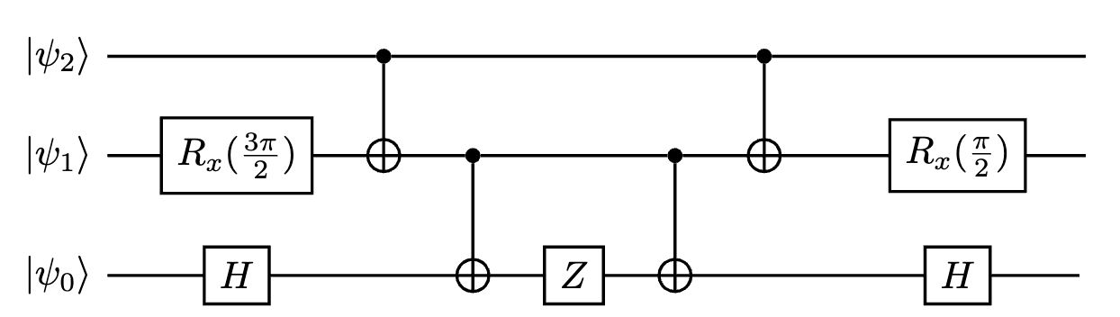
Digital quantum simulation
Unitary Synthesis
From a primitive gate set

Slide 13
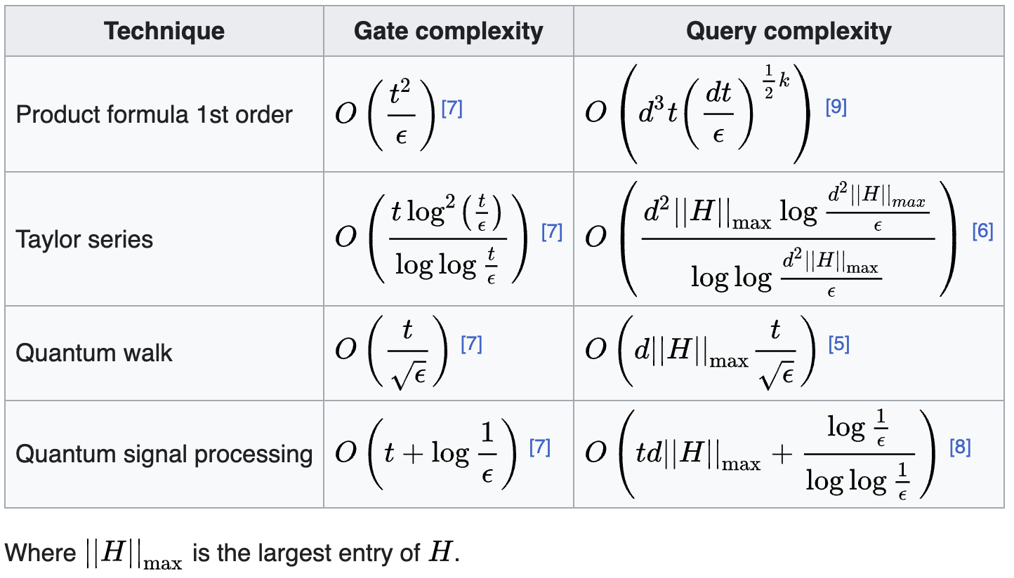
Digital quantum simulation

Slide 14
Variational Digital quantum simulation
Parameters encode the evolution for fixed ansatz
Finding a good ansatz is difficult
?

Slide 15
Trotterisation
Take a time slice of products of Pauli exponentials
Exact in the limit of infinity small time slices
Sam McArdle, Earl Campbell, and Yuan Su
Phys. Rev. A 105, 012403 – Published 3 January 2022

Slide 16

Trotterisation
In practise we need discrete $n$ time slices
Trotter error because
Sam McArdle, Earl Campbell, and Yuan Su
Phys. Rev. A 105, 012403 – Published 3 January 2022

Slide 17
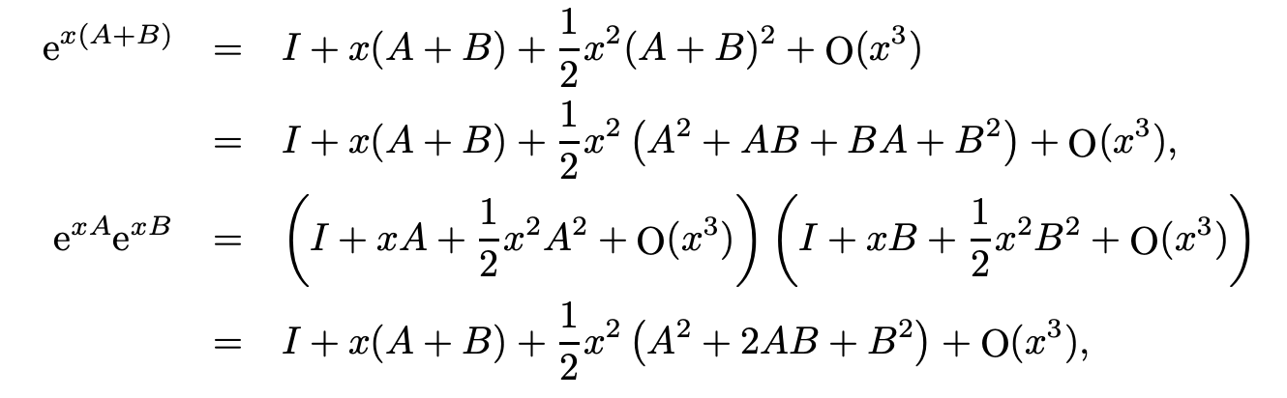
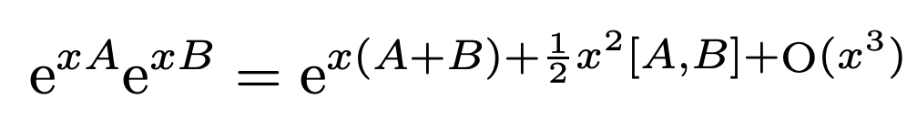
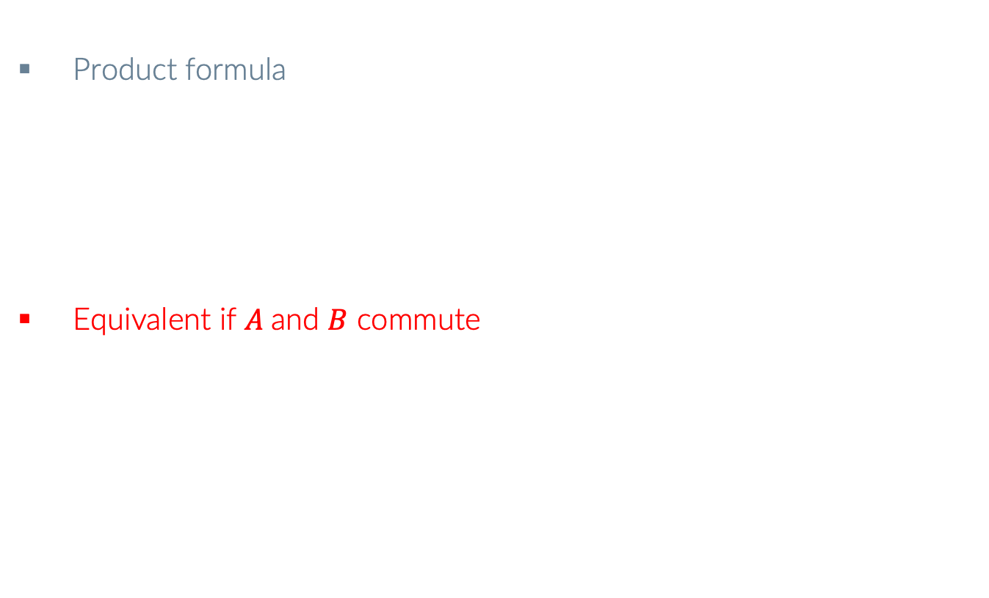
First Order Trotterisation
Exact
Product formula
Equivalent if $A$and $B$ commute
Sam McArdle, Earl Campbell, and Yuan Su
Phys. Rev. A 105, 012403 – Published 3 January 2022
math-ph/0506007

Slide 18
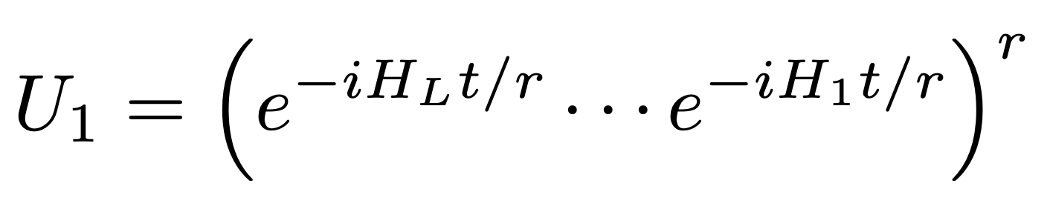
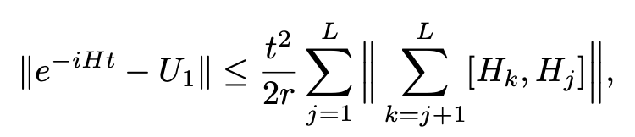
First Order Trotterisation
First order trotter product
Error in operator norm
See - A theory of trotter error for details [Childs, Su Tran, Wiebe, Zhu]
Sam McArdle, Earl Campbell, and Yuan Su
Phys. Rev. A 105, 012403 – Published 3 January 2022
math-ph/0506007

Slide 19
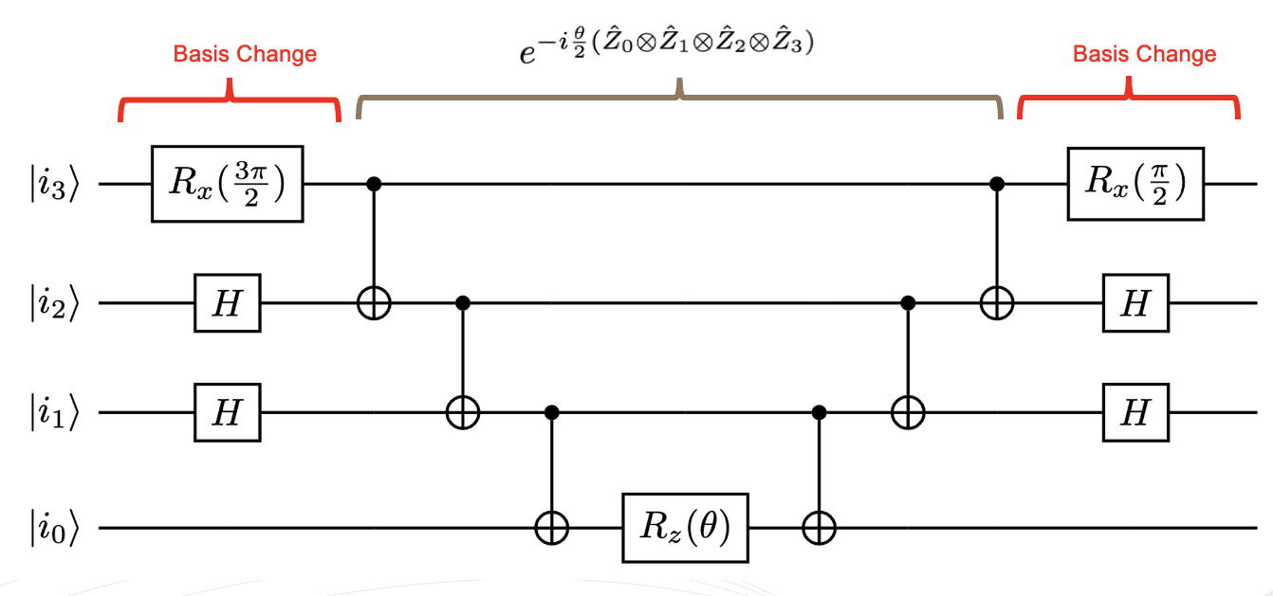
Pauli Gadgets
How do we implement Pauli exponentials?

Slide 20
Pauli Gadgets
Multi qubit parity check
Example 1 |000>

Slide 21
Pauli Gadgets
Multi qubit parity check
Example 1 |000>

Slide 22
Pauli Gadgets
Multi qubit parity check
Example 1 |000>

Slide 23
Pauli Gadgets
Multi qubit parity check
Example 1 |000>

Slide 24
Pauli Gadgets
Multi qubit parity check
Example 1 |000>

Slide 25
Pauli Gadgets
Multi qubit parity check
Example 1 |000>

Slide 26
Pauli Gadgets
Multi qubit parity check
Example 1 |111>

Slide 27
Pauli Gadgets
Multi qubit parity check
Example 1 |111>

Slide 28
Pauli Gadgets
Multi qubit parity check
Example 1 |111>

Slide 29
Pauli Gadgets
Multi qubit parity check
Example 1 |111>

Slide 30
Pauli Gadgets
Multi qubit parity check
Example 1 |111>

Slide 31
Pauli Gadgets
Multi qubit parity check

Slide 32
Pauli Gadgets
Basis Change
Basis Change

Slide 33
Pauli Gadgets
Exercise to prove:
Why are we doing this?

Slide 34
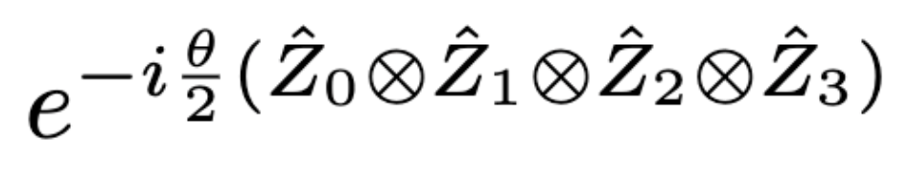
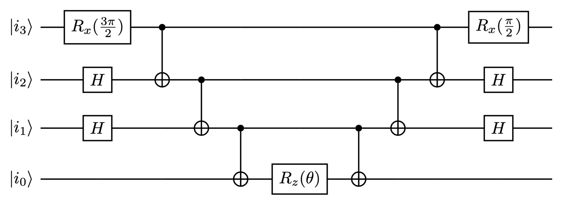
Pauli Gadgets
Very useful circuit primitive
Basis Change
Basis Change

Slide 35
Trotterisation

Slide 36
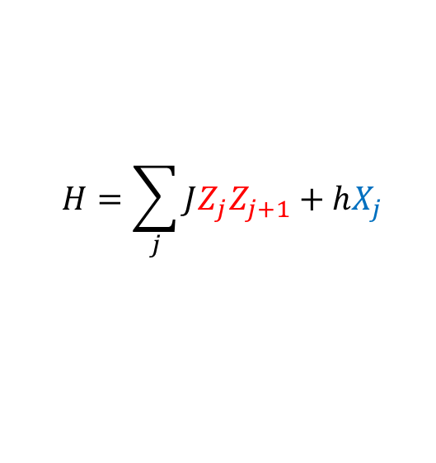
Hardware experiment
$$H=\sum_{j}{JZ_{j}Z_{j+1}+hX_{j}}$$
$$U\left(t\right)≈{\left(e^{−iZ_{1}Z_{2}Jδt}e^{−iZ_{2}Z_{3}Jδt}⋯e^{−iX_{1}hδt}e^{−iX_{2}hδt}⋯\right)}^{n}$$
rzz gates
rx gates

Slide 37
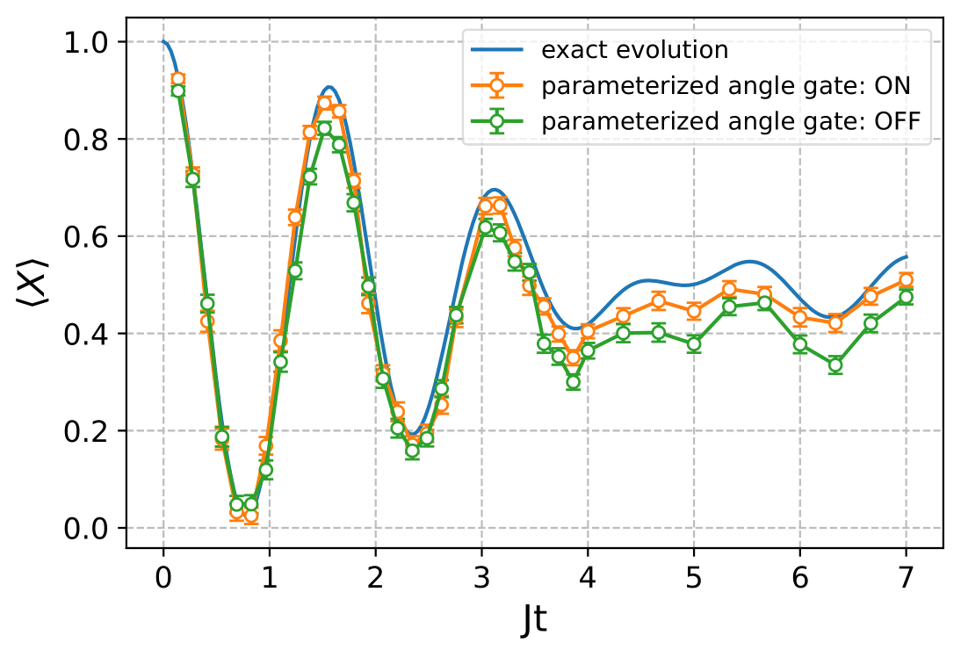
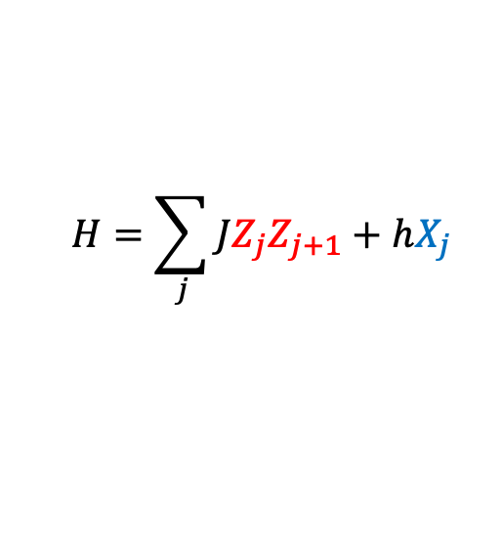
Hardware experiment
$$H=\sum_{j}{JZ_{j}Z_{j+1}+hX_{j}}$$
32 Qubits
No Error Mitigation
Initial state:
arXiv:2305.03828

Slide 38
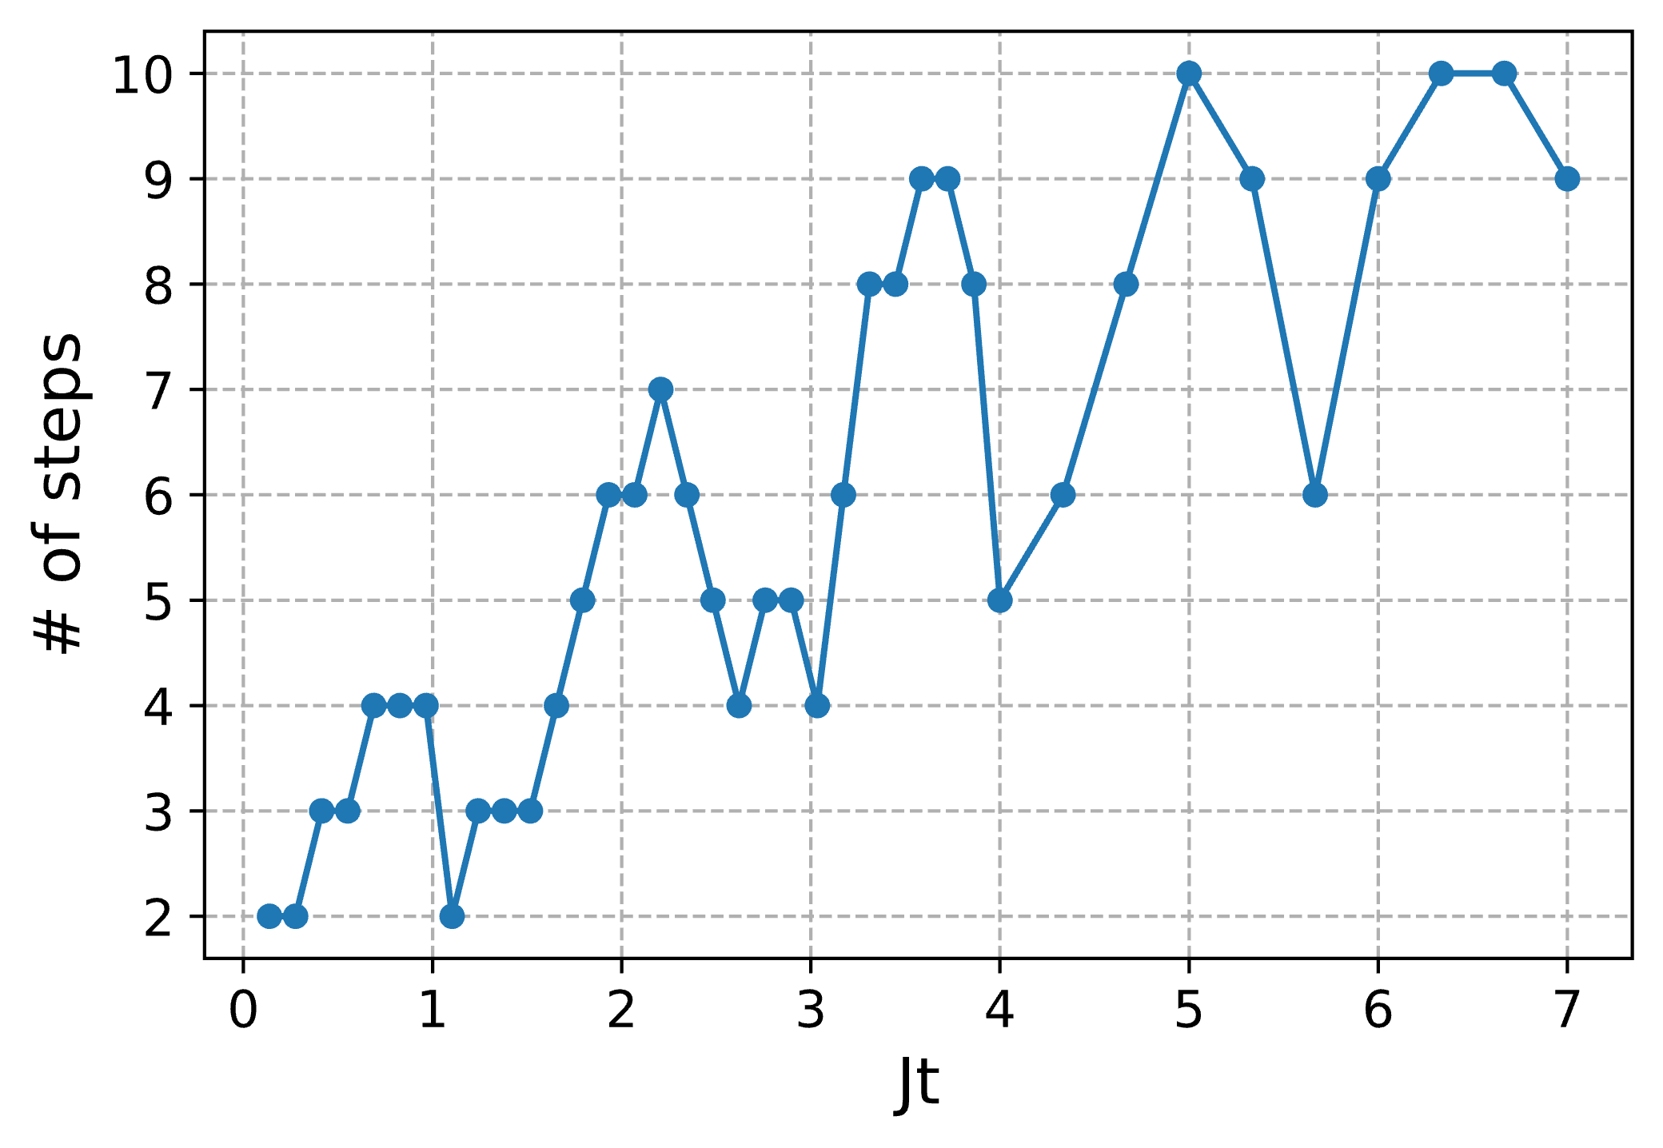
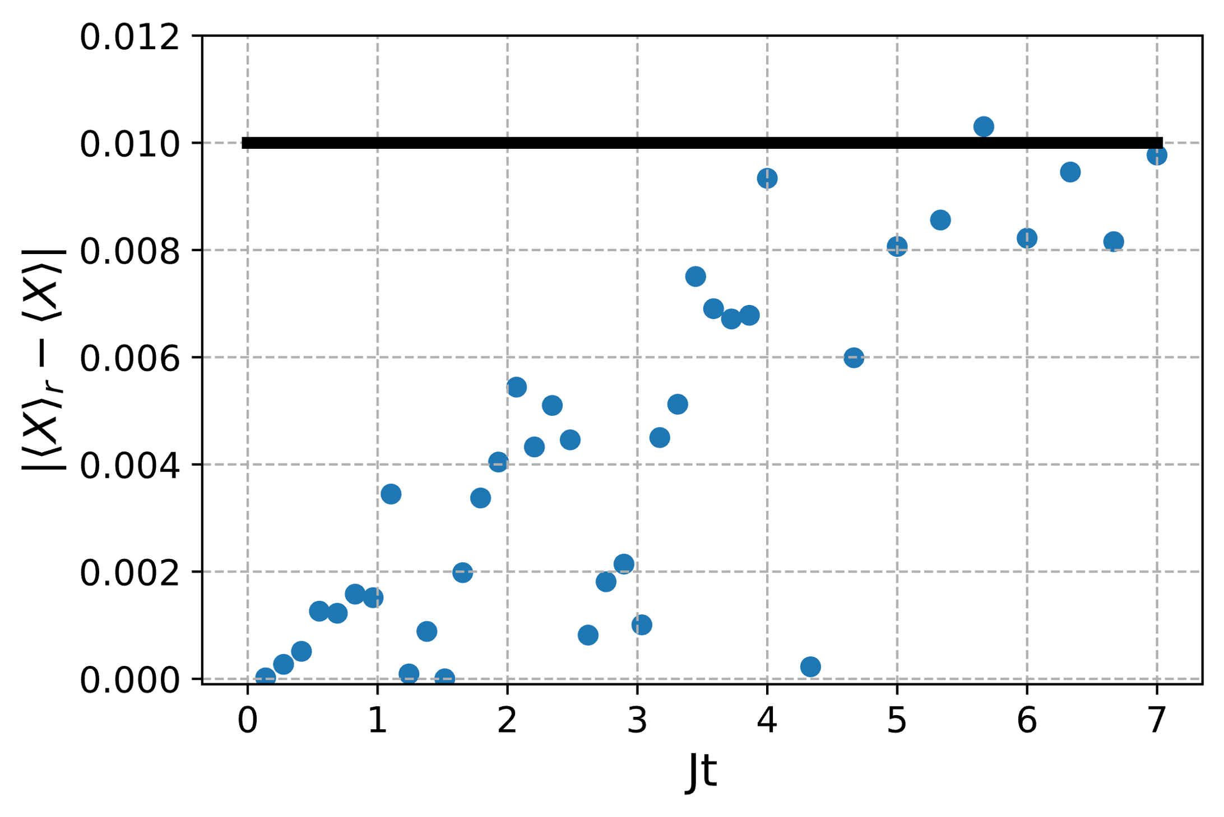
Hardware experiment
The # of trotter steps used for each sim. time
The absolute trotter error with the step used for each time
Step size was increased until result changed by less than expected shot noise of 0.05
Max depth of 80 2 qubit gate rounds.
Noiseless cases

Slide 39
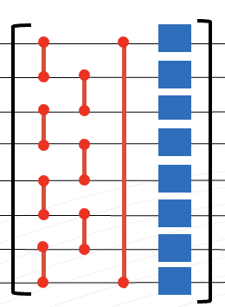
Other Trotterised Systems
Local
Non Local
Local Hamiltonians lead to trotter steps with very efficient stacking Pauli gadgets – Shallow circuits
Non local Hamiltonians have very inefficient stacking of Pauli gadgets – Deep circuits
Trotter not very efficient for complicated quantum Chemistry Hamiltonians

Slide 40
Phase Estimation
For Hamiltonians
When Applied to a given eigen state

Slide 41
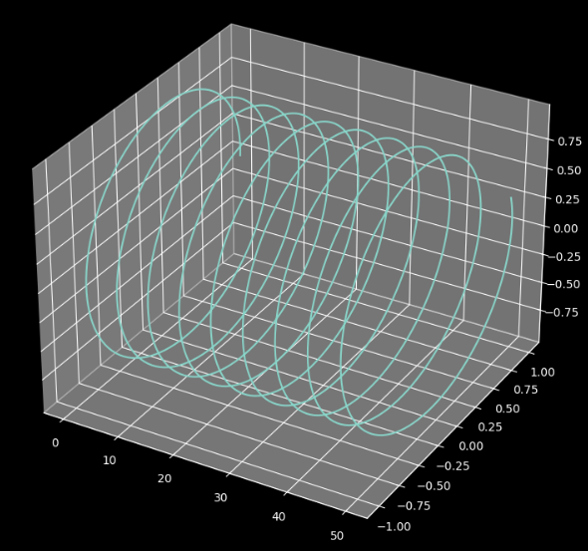
Phase Estimation
Transition matrix elements
When Applied to a given eigen state

Slide 42
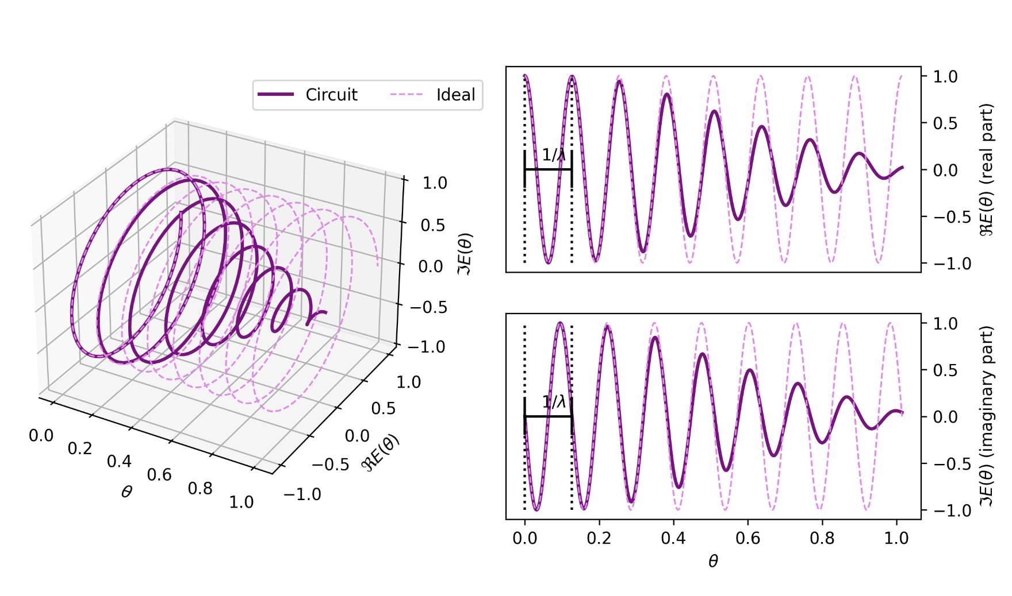
Phase Estimation
Trotter error dampens the signal

Slide 43
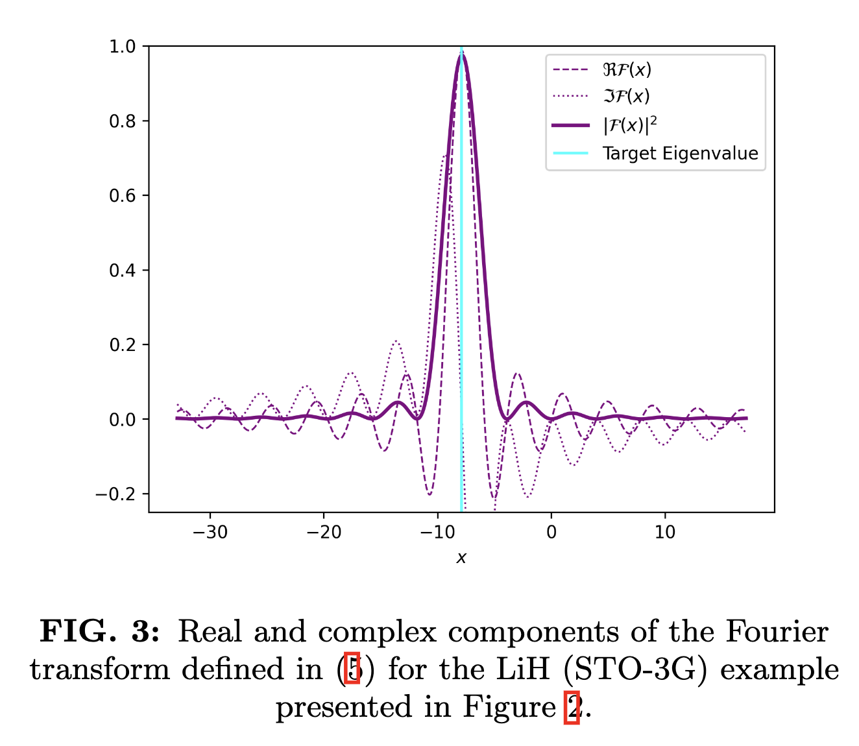
Phase Estimation

Slide 44
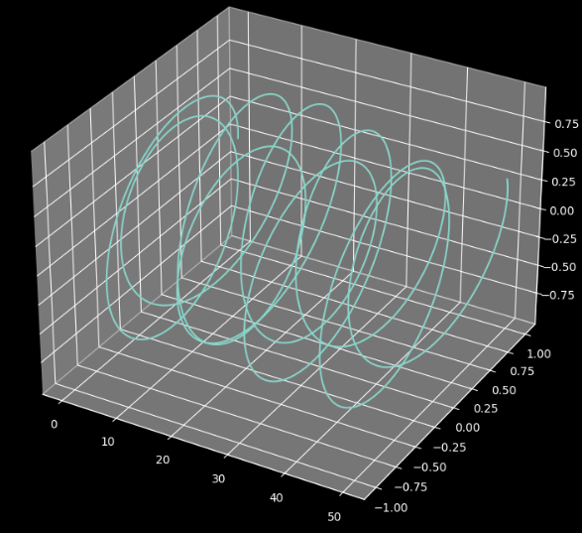
Phase Estimation
Transition matrix elements
When Applied to a linear combination eigen states
State preparation a difficult problem for phase estimation

Slide 45
Fourier expansion
Exponential Form

Slide 46
Quantum Fourier Transform
Exponential Form
Discrete Fourier Transform on x
Fourier Coefficents

Slide 47
Quantum Fourier Transform
QFT is a linear map
Unitary basis change matrix of Fourier coefficients

Slide 48
Quantum Fourier Transform
QFT acting on vector x
Gives new vector y

Slide 49
Quantum Fourier Transform
3 qubit example
Looping around $ω^{8}$
8 x 8 unitary matrix

Slide 50
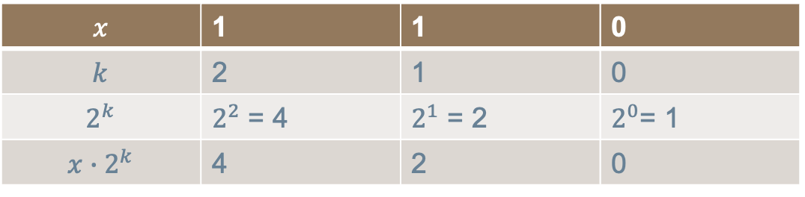
Quantum Fourier Transform
Binary notation
$$x$$ | 1 | 1 | 0
$$k$$ | 2 | 1 | 0
$$2^{k}$$ | $2^{2}$ = 4 | $2^{1}$ = 2 | $2^{0}$= 1
$${x∙2}^{k}$$ | 4 | 2 | 0

Slide 51
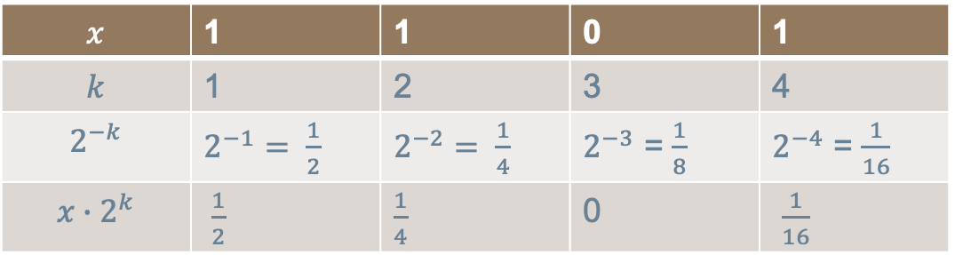
Quantum Fourier Transform
Fixed point binary fraction notation
$$x$$ | 1 | 1 | 0 | 1
$$k$$ | 1 | 2 | 3 | 4
$$2^{−k}$$ | $2^{−1}= \frac{1}{2}$ | $2^{−2}= \frac{1}{4}$ | $2^{−3}$ = $\frac{1}{8}$ | $2^{−4}$ = $\frac{1}{16}$
$${x∙2}^{k}$$ | $\frac{1}{2}$ | $\frac{1}{4}$ | 0 | $\frac{1}{16}$

Slide 52
Quantum Fourier Transform
3 qubit example
Insert fixed point binary fraction identity
Summation in exponetial

Slide 53
Quantum Fourier Transform
3 qubit examplex
Break exponential summation into constituent bit tensors

Slide 54
Quantum Fourier Transform
3 qubit example
|0> terms always weighted 1:

Slide 55
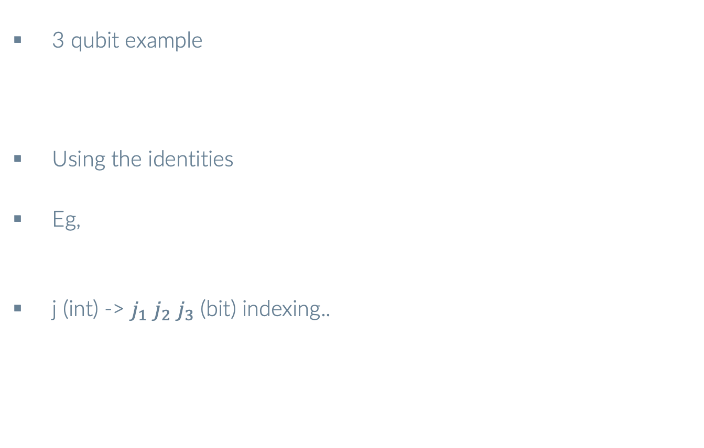
Quantum Fourier Transform
3 qubit example
Using the identities
Eg,
j (int) -> $j_{1}$ $j_{2}$ $j_{3}$ (bit) indexing..

Slide 56
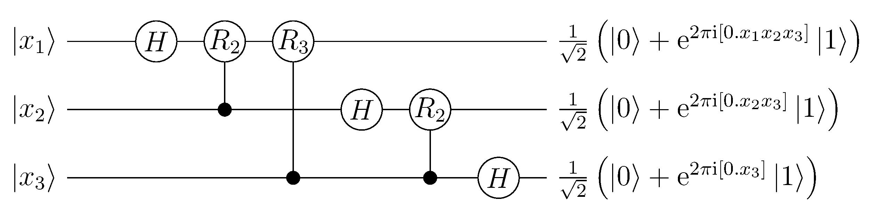
Quantum Fourier Transform
3 qubit example

Slide 57
Quantum Fourier Transform
3 qubit example

Slide 58
Quantum Fourier Transform
3 qubit example
Bit to integer mapping

Slide 59
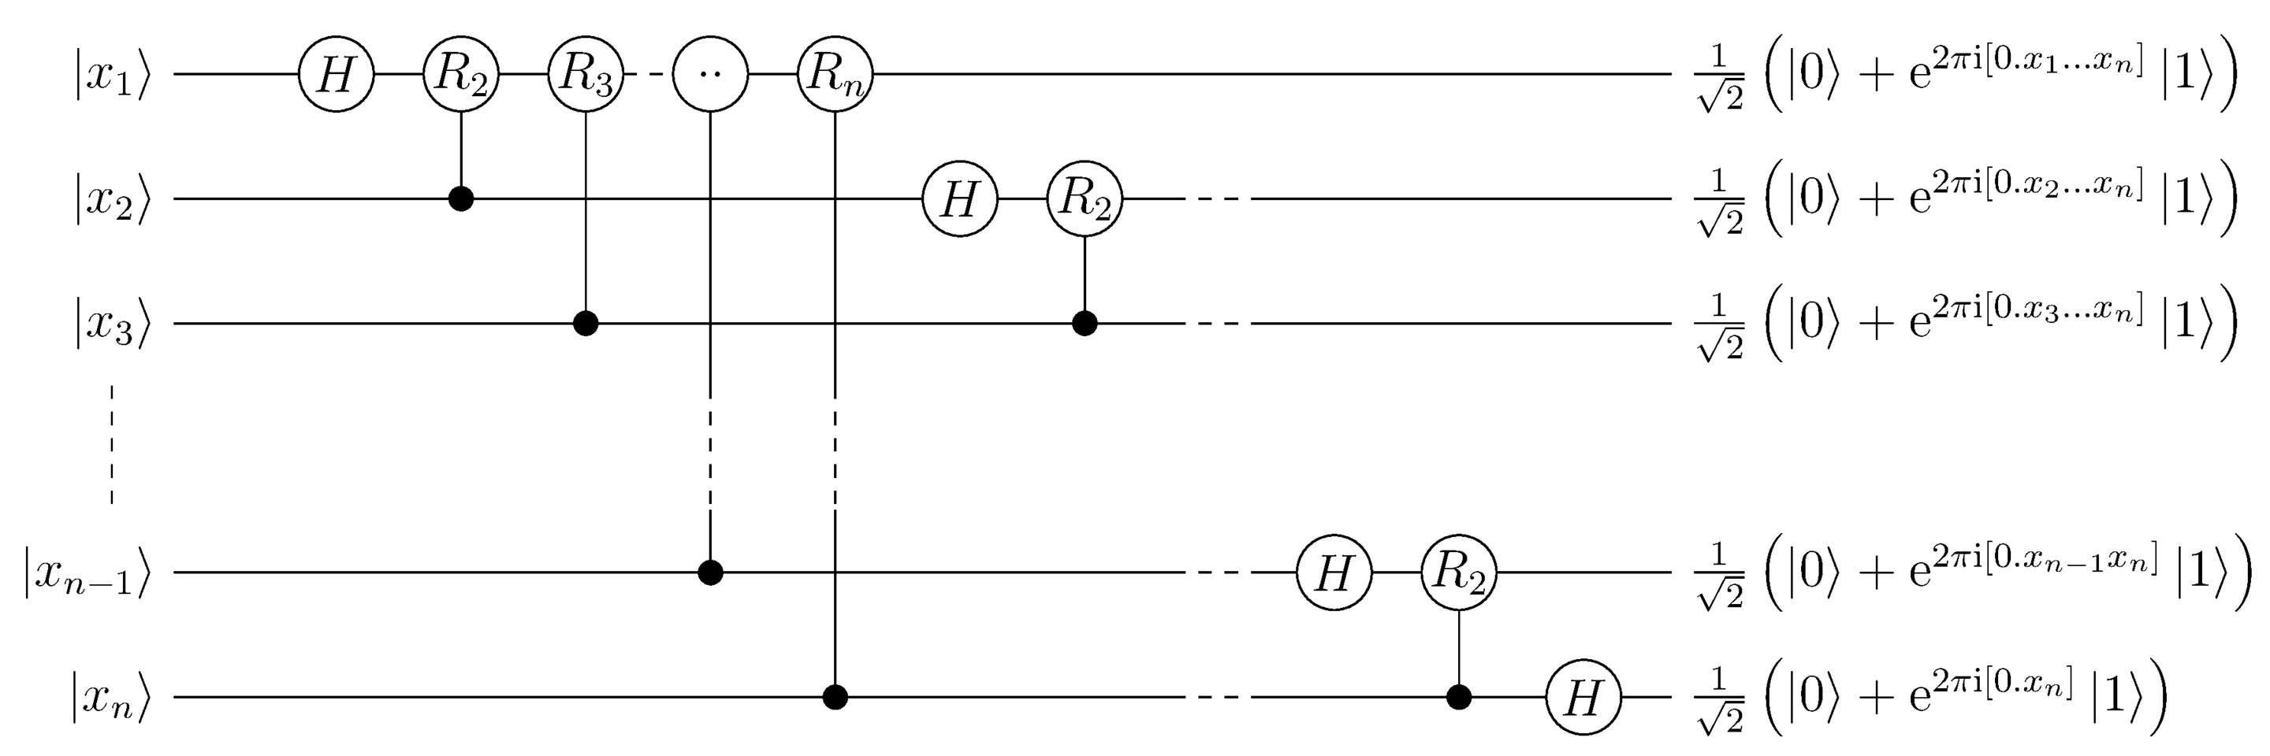
Quantum Fourier Transform
Generally

Slide 60
Quantum Fourier Transform
3 qubit example
Cancel denominator in result
Bit to integer mapping

Slide 61
Inverse Quantum Fourier Transform
3 qubit example
iQFT maps to bit string

Slide 62
Inverse Quantum Fourier Transform
We take advantage of this extraction property of the iQFT in phase Estimation
iQFT maps to bit string
We can encode a phase into the input and extract it by measurement
How to get the phases into the input

Slide 63

Inverse Fourier Transform
The Fourier basis input
Maps to state $x_{1}$ $x_{2}$ $x_{3}$
Storing information in the fourier basis and extracting with iQFT is the game of Phase Estimation

Slide 64
Inverse Quantum Fourier Transform
iQFT maps to bit string in fixed point binary representation
We can encode a phase into the input and extract it by measurement
How to get the phases into the input

Slide 65
Quantum Fourier Transform
Fixed point binary fraction notation
$$x$$ | 1 | 1 | 0 | 1
$$k$$ | 1 | 2 | 3 | 4
$$2^{−k}$$ | $2^{−1}= \frac{1}{2}$ | $2^{−2}= \frac{1}{4}$ | $2^{−3}$ = $\frac{1}{8}$ | $2^{−4}$ = $\frac{1}{16}$
$${x∙2}^{k}$$ | $\frac{1}{2}$ | $\frac{1}{4}$ | 0 | $\frac{1}{16}$

Slide 66
Phase Kick Back
How do we get information into the Fourier basis?
Controlled U acting on ancilla and eigenvector of U
Eigenphase goes to ancilla |1> leaving system unchanged

Slide 67
Phase Kick Back
Powers of unitaries
You can see where this is going…

Slide 68
Phase Estimation
Step 1
x

Slide 69
Phase Estimation
Step 2
Multiples of phase added to ancillas via controlled powers of unitaries
x

Slide 70
Phase Estimation
Step 3
Extract bit string values and calculate value using

Slide 71
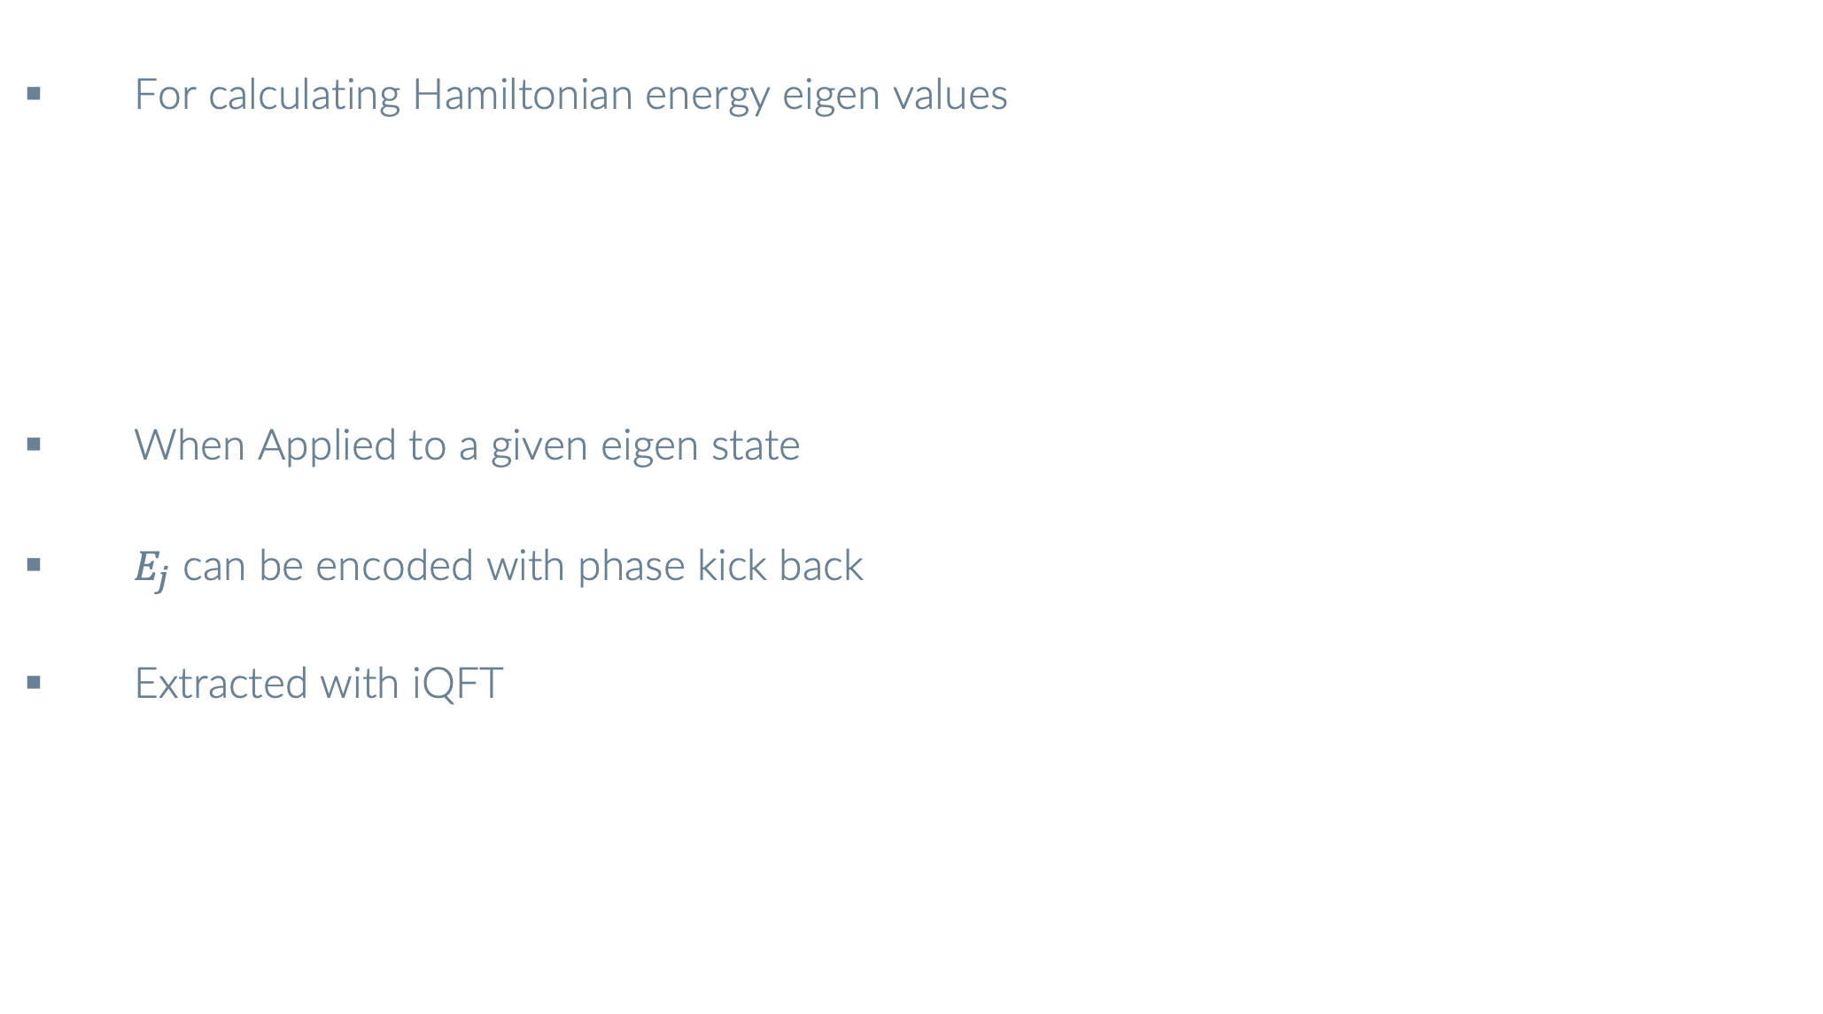
Phase Estimation
For calculating Hamiltonian energy eigen values
When Applied to a given eigen state
$E_{j}$ can be encoded with phase kick back
Extracted with iQFT

Slide 72
Phase Estimation
Step 1
x

Slide 73
Phase Estimation
Step 2
x

Slide 74
Phase Estimation
Step 3
Extract bit string values and calculate value using

Slide 75
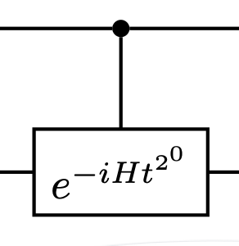
Phase Estimation
How to implement controlled time evolution?

Slide 76
Phase Estimation
Similarity transform structure

Slide 77
Phase Estimation
Control only the U

Slide 78
Phase Estimation
Can we do this with less deep circuits?
The eigenvalue information is contained in the transition matrix element
Use the Hadamard test

Slide 79
Hadamard test
Allows calculation of real or imaginary expectation values of unitaries

Slide 80
Hadamard test
Allows calculation of real or imaginary expectation values of unitaries

Slide 81
Hadamard test
Allows calculation of real or imaginary expectation values of unitaries

Slide 82
Hadamard test
Allows calculation of real or imaginary expectation values of unitaries

Slide 83
Hadamard test
Allows calculation of real or imaginary expectation values of unitaries
Group the terms

Slide 84
Hadamard test
Allows calculation of real or imaginary expectation values of unitaries

Slide 85
Hadamard test
Allows calculation of real or imaginary expectation values of unitaries

Slide 86
Hadamard test
Allows calculation of real or imaginary expectation values of unitaries

Slide 87
Hadamard test
imag

Slide 88
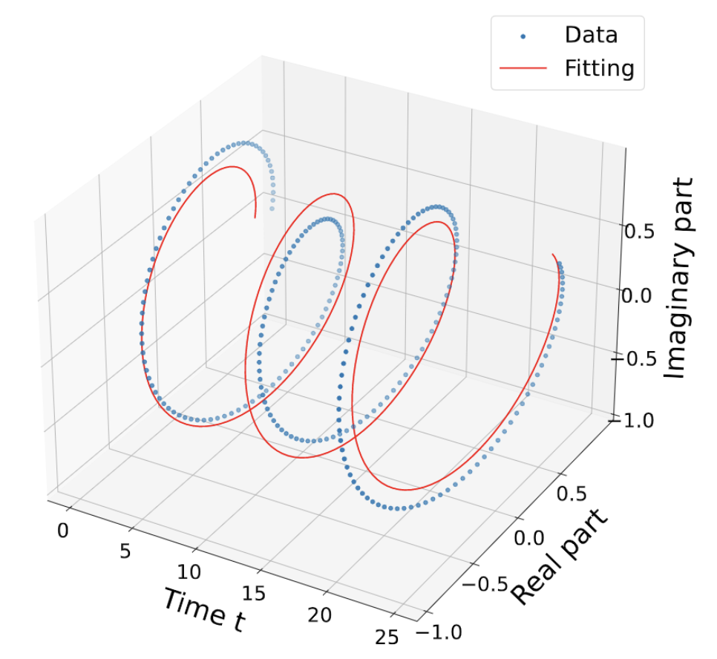
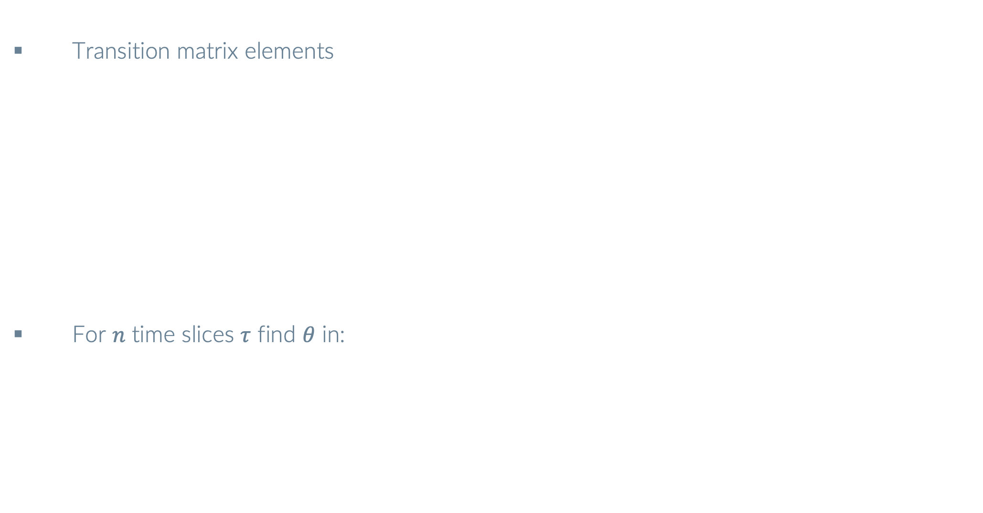
QCELS – Quantum Complex Exponential Least Squares
Transition matrix elements
For $n$ time slices $τ$ find $θ$ in:
Zhiyan Ding and Lin Lin
PRX Quantum 4, 020331 – Published 26 May 2023

Slide 89
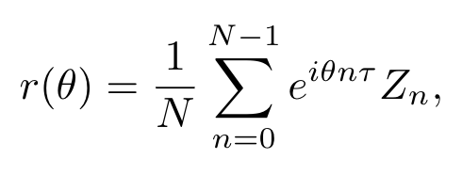
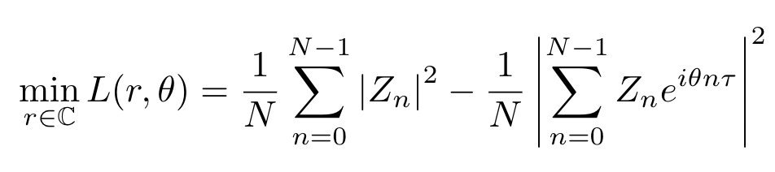

Derivatives
For a fixed value of $θ$ the minimisation of $L$ wrt to $r GIVES$:
Sub back in:

Slide 90
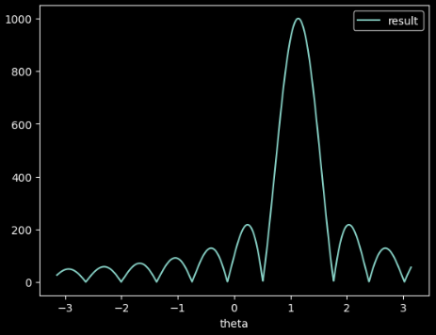
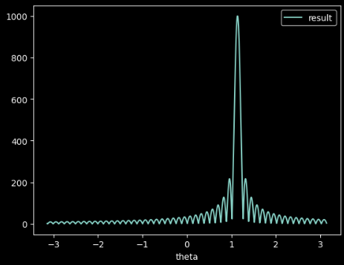
Derivatives
Minimization of L equivalent to maximizing
Exact eigenstate initial state
Larger n

Slide 91



QCELS - EXAMPLe
Exact Init
Approx Init
Larger n

Slide 92
Exact Diagonalisation
Basis:
Hamitonian matrix elements
Overlap matrix elements
Exponentially large

Slide 93
Krylov Methods
Kyrlov Basis:
Powers of functions of H
Weighted linear combination
Smaller GEVP to solve (10 – 100s)

Slide 94
Krylov Methods
Kyrlov GEVP:
Hamiltonian matrix elements
Overlap matrix elements
Complexity shifted to matrix element calculation

Slide 95

Krylov Methods $f(H)$
Matrix function via SVD:
Real time evolution
Imaginary time evolution
Chebyshev polynomials (recursive double angle formulas)
Lots of open research in this area

Slide 96
Unitary KryloV
Real time evolution
Hamiltonian matrix elements
Overlap Matrices

Slide 97
Unitary KryloV
All the elements of
Generated from a set
Significantly reducing the number of elements compared to the standard krylov

Slide 98
Linear Combination of Unitaries
In most cases the Hamiltonian is a weighted linear combination of unitary Paulis
Unitary Pauli needs to be measured individually or in commuting sets
Coefficient then multiplied with the result

Slide 99
Linear Combination of Unitaries
Can we apply the whole non unitary Hamiltonian to a state at the circuit level?
Can we measure the whole Hamiltonian expectation value at once?
Use Linear Combination of Unitaries (LCU) block encoding strategy

Slide 100

Linear Combination of Unitaries
Toy example

Slide 101
Linear Combination of Unitaries

Slide 102
Linear Combination of Unitaries

Slide 103
Linear Combination of Unitaries

Slide 104
Linear Combination of Unitaries

Slide 105
Block encoding
Operator
Renormalised block encoding if ||h|| > 1. If H is unitary ||h|| = 1

Slide 106

Linear Combination of Unitaries
Oracle framework
Childs, Wiebe - arXiv:1202.5822

Slide 107


Prepare oracle
$PREPARE$
Encode renormalised Hamiltonian term coefficients onto unique bit strings
Arbitrary state preparation – Logarithmic qubit scaling in number Hamiltonian terms

Slide 108


Select oracle
$SELECT$
Weighted bit strings applied to Hamiltonian Pauli terms applied $\left.|ψ\right\rangle$

Slide 109


Unprepare Oracle
${PREPARE}^{†}$
Rotate weighted Paulis back onto |000>

Slide 110

Post selection
Measure |000>
Projects into |0…0> <0…0| block of $U_{LCU}$

Slide 111
LCU Success Probability
Post selection success probability
How unitary H is
Amplitude amplification may need to be used
Lots of work manipulating the Hamiltonian to improve P - Artur Izmylov [1]
[1]Quantum Science and Technology, Volume 8, Number 3

Slide 112

LCU HaDAMARD TEST
Single Measurement
Naive Qcontrol Box compilation strategy

Slide 113
LCU HaDAMARD TEST
Similarity transfor structure

Slide 114

LCU Hadamard Test
Single Measurement

Slide 115

Prepare oracle
Serial with multi controls - very deep circuits
Must be real - complex/negative sign can be absorbed later into select
Can be decomposed using the theory of multiplexors

Slide 116
Select

Slide 117

Serial Pauli Select Compilation
Most straight forward method
Can be done with Qcontrol box in pytket
Leads to many multi controlled gates to be decomposed by pytket

Slide 118

Serial Pauli Select Compilation
Linear depth circuit decomposition of CnU
Adenilton J. da Silva and Daniel K. Park
Phys. Rev. A 106, 042602 – 2022

Slide 119

Serial Pauli Select Compilation

Slide 120
Pauli Gadgets
Basis Change
Basis Change

Slide 121
Pauli Gadget Select Compilation
Similarity transform structure
only U needs to be controlled

Slide 122
Pauli Gadget Select Compilation
Multicontrols decomposed with pytket
[1] A. Ralli, Phys. Rev. Research 3, 033195

Slide 123
Pauli Gadget Select Compilation
Coefficient phases implemented with basis change on the SELECT Z

Slide 124


Quantum MulTiplexor GAte
2Q example
Can be verified easily by matrix multiplication

Slide 125
Quantum MulTiplexor GAte
3 example
Recursion relation
Can be verified easily by matrix multiplication
Same as PREPARE oracle

Slide 126


Quantum MulTiplexor GAte
$U=$ $\left[a,b\right]$SU(2)
Solve $\left[a,b,R_{Z}\right]$from the matrix equation
Bergholm - arXiv:quant-ph/0410066 2004

Slide 127


Quantum MulTiplexor GAte
$V=$ [$V_{0},V_{1}$, $V_{2}$, $V_{3}]$ SU(2)

Slide 128

Quantum MulTiplexor GAte
Similar recursion relation

Slide 129



Quantum MulTiplexor GAte
3 qubit example
[$u_{0},u_{1}$, $u_{2}$, $u_{3}]$ continuous angle rotations

Slide 130

Quantum MulTiplexor GAte
$e^{iφ}$ of coefficient can be pulled into first select qubit

Slide 131
Fermionic Hamiltonians
Hubbard Model
Linear Scaling

Slide 132

Hamiltonians
Quantum Chemistry Hamiltonian
$n^{4}$ scaling

Slide 133
JW transform
8 times more quartic terms
2 times more quadratic terms
Z strings have implications on Serial and PauliG compilation

Slide 134

Hubbard Series Results

Slide 135

Stretched Hydrogen Ring Results

Slide 136

Stretched Hydrogen Ring Results

Slide 137
Block encoded Singular Value Decomposition
Matrix
Block encoded quantum circuit
Implicit SVD
Ralli, Love, Tranter, Coveney - PHYSICAL REVIEW RESEARCH 3, 033195 (2021)

Slide 138
Block encoded Singular Value Transform
Matrix Function
Block encoded singular value transform
Need a quantum circuit
Ralli, Love, Tranter, Coveney - PHYSICAL REVIEW RESEARCH 3, 033195 (2021)

